Slide 1


Jacob Tarter
12/5/2021

Slide 2

Outline
Executive Summary
Introduction
Methodology
Results
Conclusion
Appendix

Slide 3
Executive Summary
Summary of methodologies
Data Collection
Data Wrangling
EDA with Data Visualization
EDA with SQL
Built an interactive map with Folium
Built a Dashboard with Plotly Dash
Predictive Analysis (Classification)
Summary of all results
Exploratory data analysis results
Interactive analytics demonstrations available by screenshots
Predictive analysis results

Slide 4
Introduction
Project background and context
SpaceX is the way of the future of commercial space travel: its Falcon 9 rocket costs just 62 million dollars to launch, compared to competitors that charge upwards of 165 million dollars. SpaceX is able to be cost competitive by being able to reuse the first stage of its Falcon 9 rocket. Therefore, by using publicly available launch data, it is possible to predict whether a Falcon 9’s first stage will land after delivering a payload, which can be used by competitors to big against SpaceX for commercial rocket launches.
Problems solved by this project
Determining what influences a successful Falcon 9 launch / first stage landing
The effect of each influencing variable on the success rate of a first stage landing
The conditions necessary for SpaceX to achieve a successful first stage landing

Slide 5


Slide 6
Methodology
Executive Summary
Data collection methodology:
Data for this project was collected by using the SpaceX Rest API and scrapping additional data from Wikipedia
Perform data wrangling
One hot encoded data fields for machine learning and removed unnecessary columns
Perform exploratory data analysis (EDA) using visualization and SQL
Perform interactive visual analytics using Folium and Plotly Dash
Perform predictive analysis using classification models
How to build, tune, evaluate classification models

Slide 7
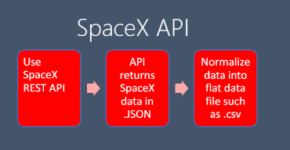
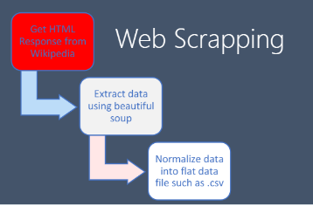
Data Collection
SpaceX launch data was acquired via the SpaceX Rest API
Additional data was gathered by web scraping Wikipedia
Data included rocket used, payload delivered, launch specifications, landing specifications, and landing outcome, etc.

Slide 8
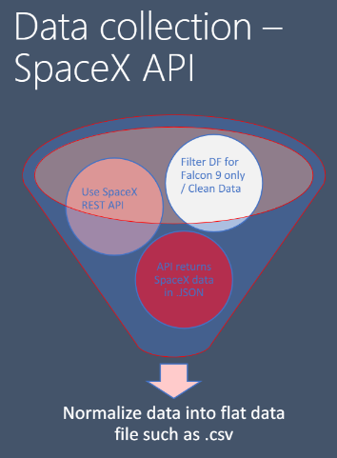
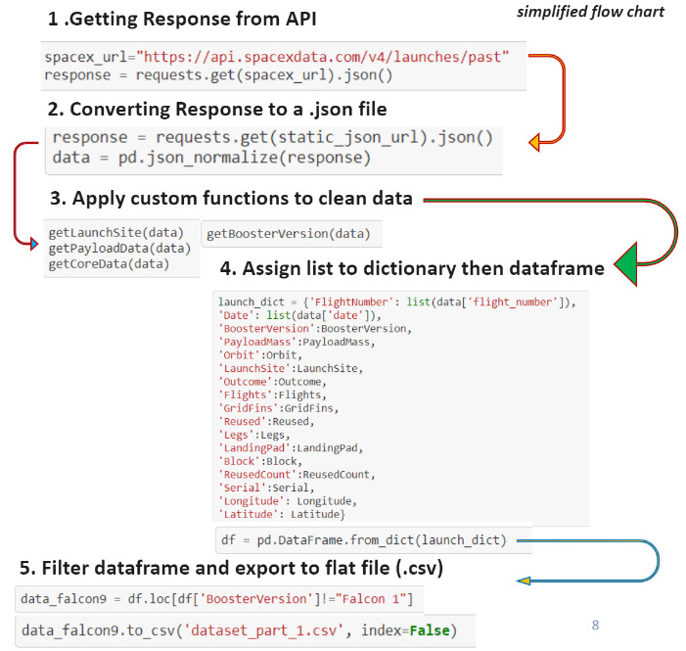
Data Collection – SpaceX API
Link to Notebook

Slide 9
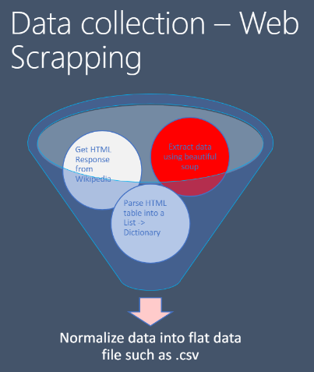
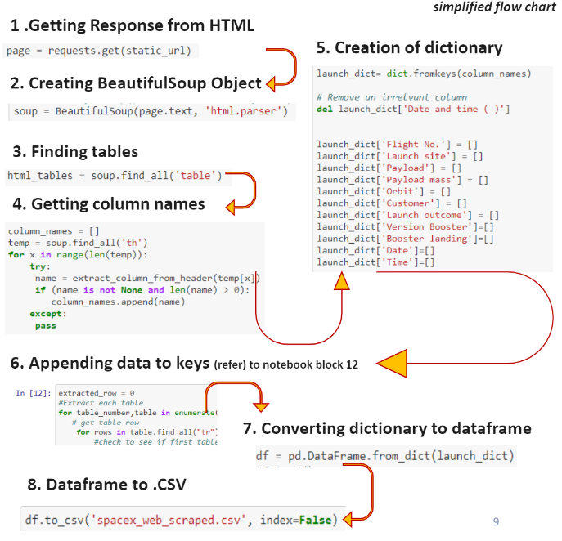
Data Collection - Scraping
Link to Notebook

Slide 10
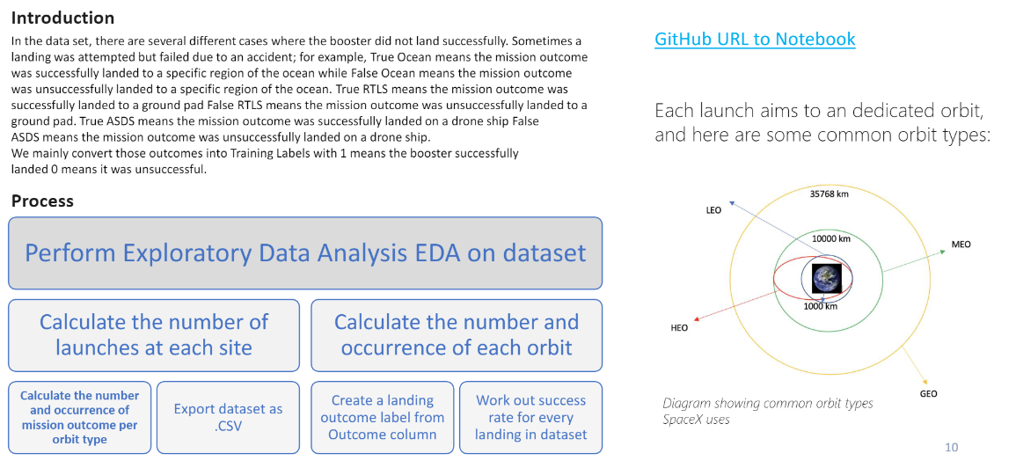
Data Wrangling
Link to Notebook

Slide 11
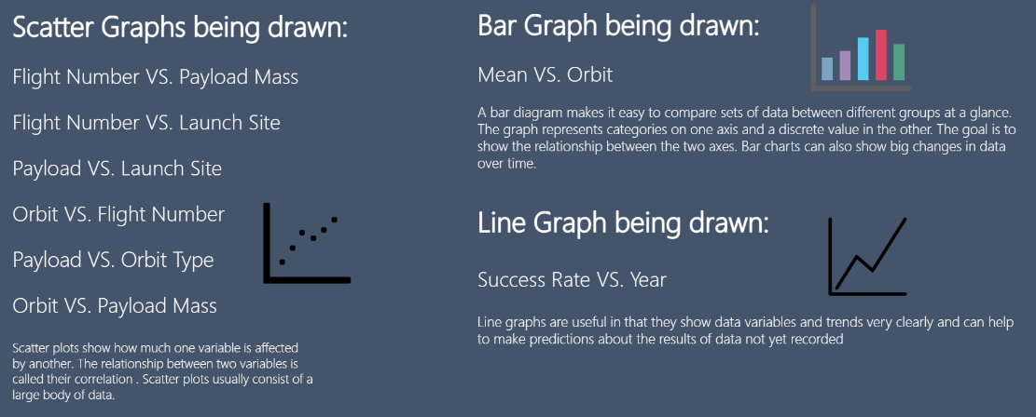
EDA with Data Visualization
Link to Notebook

Slide 12
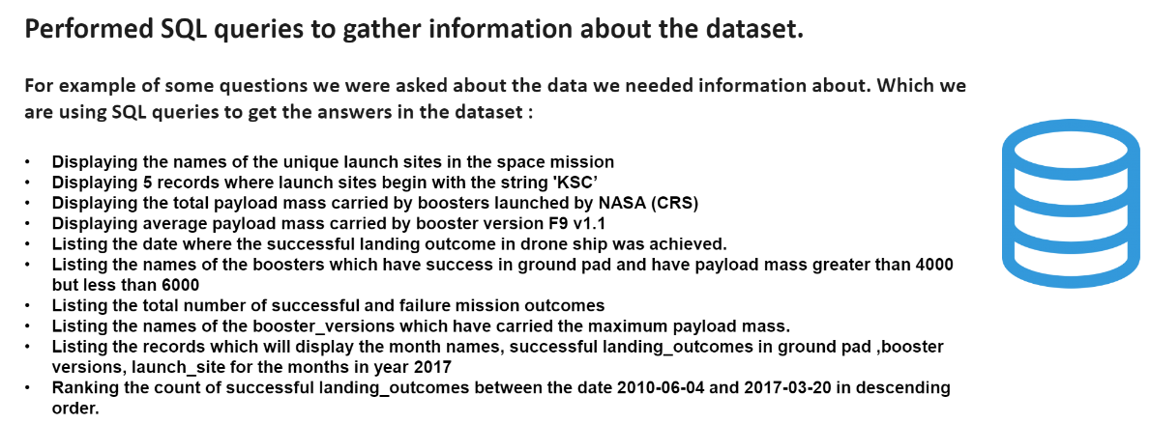
EDA with SQL
Link to Notebook

Slide 13
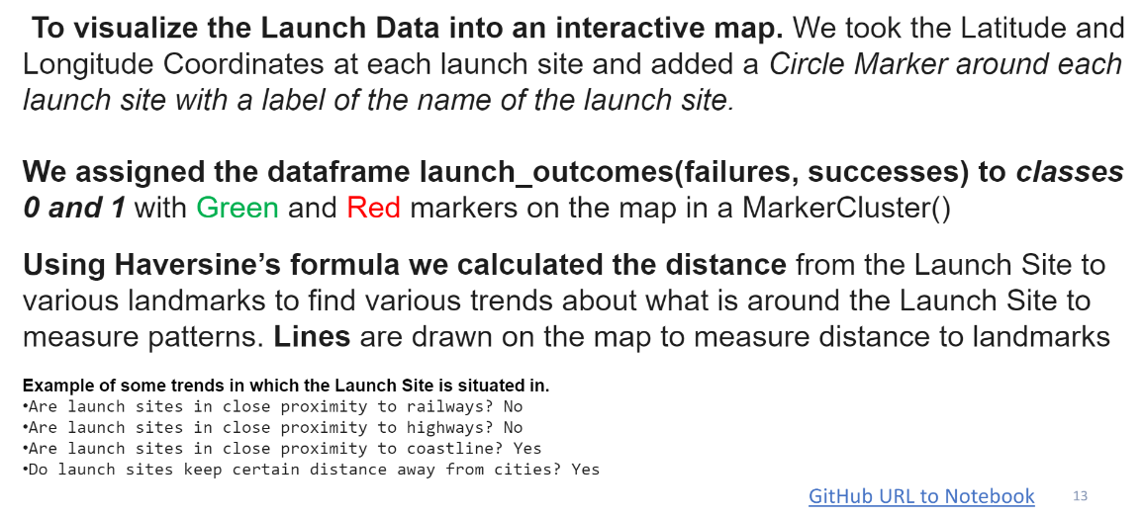
Build an Interactive Map with Folium
Link to Notebook

Slide 14
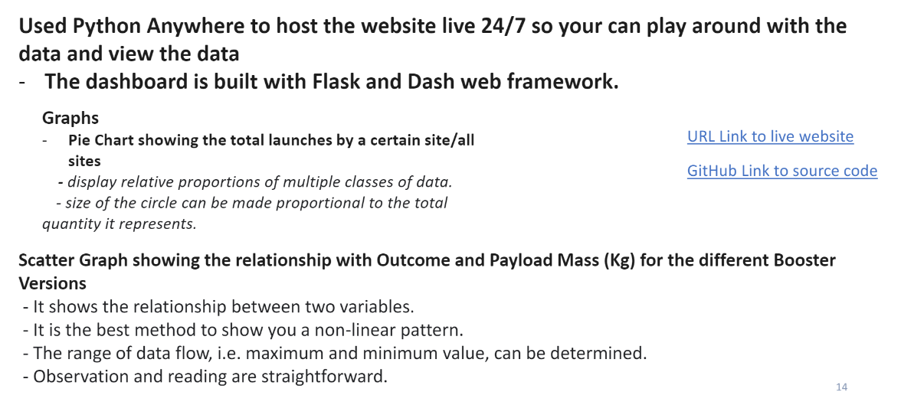
Build a Dashboard with Plotly Dash
Link to Notebook

Slide 15
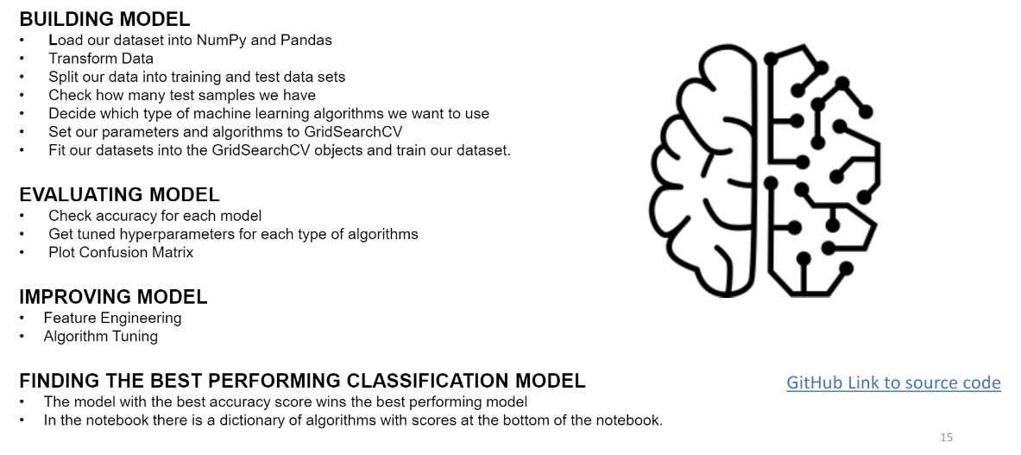
Predictive Analysis (Classification)
Link to Notebook

Slide 16
Results
Exploratory data analysis results
Interactive analytics demo in screenshots
Predictive analysis results

Slide 17


Slide 18
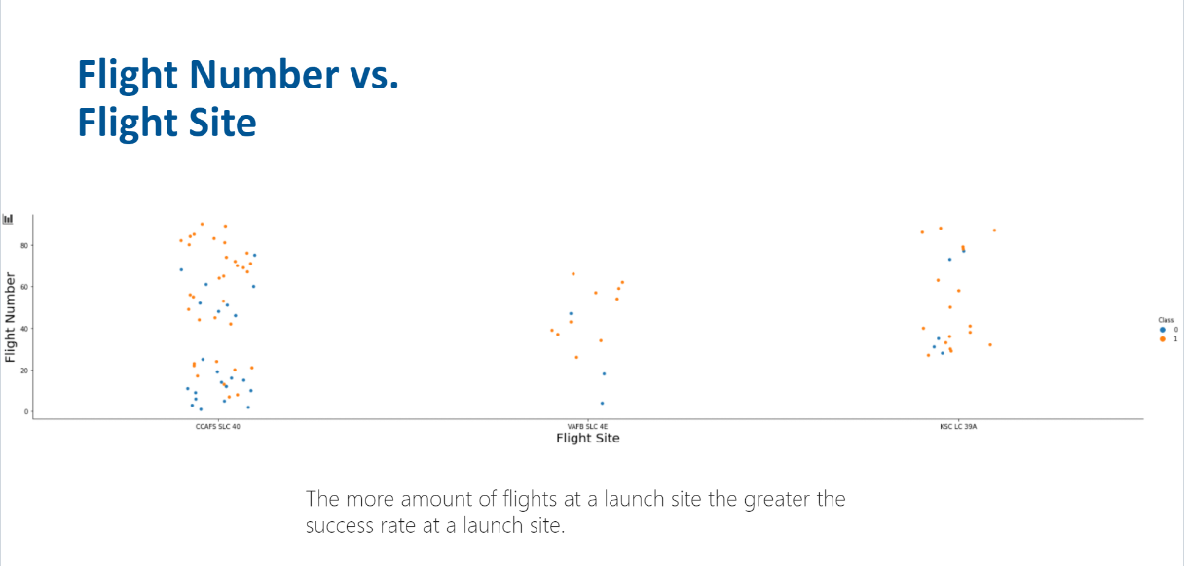
Flight Number vs. Launch Site

Slide 19
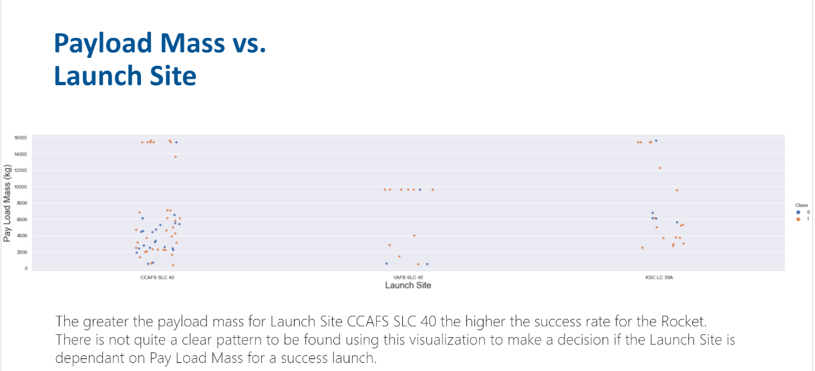
Payload vs. Launch Site

Slide 20
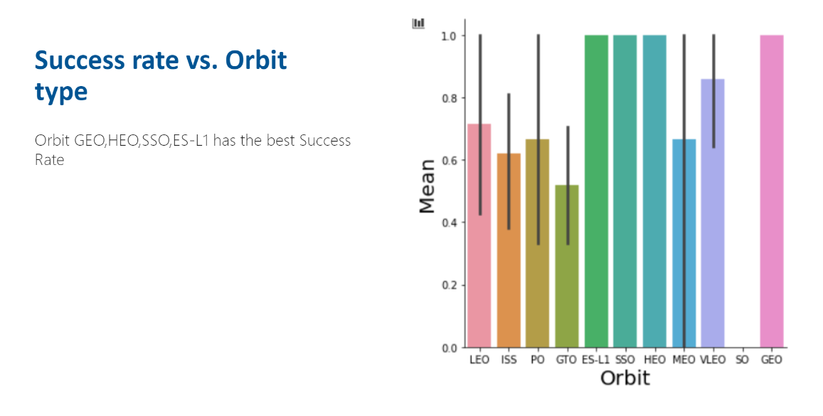
Success Rate vs. Orbit Type

Slide 21
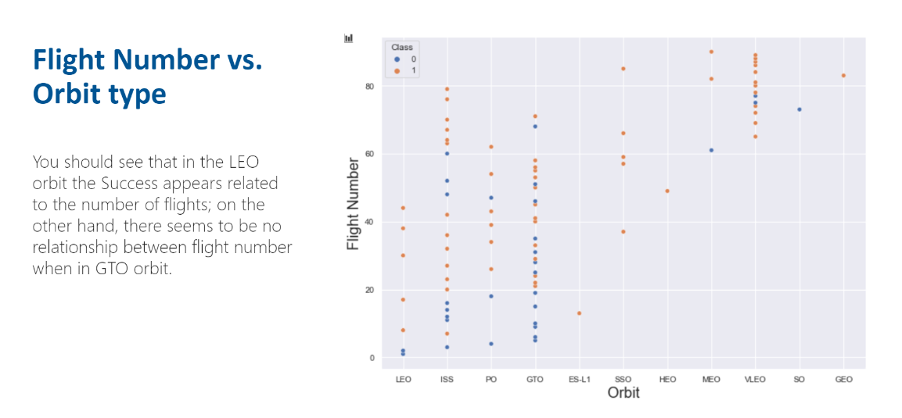
Flight Number vs. Orbit Type

Slide 22
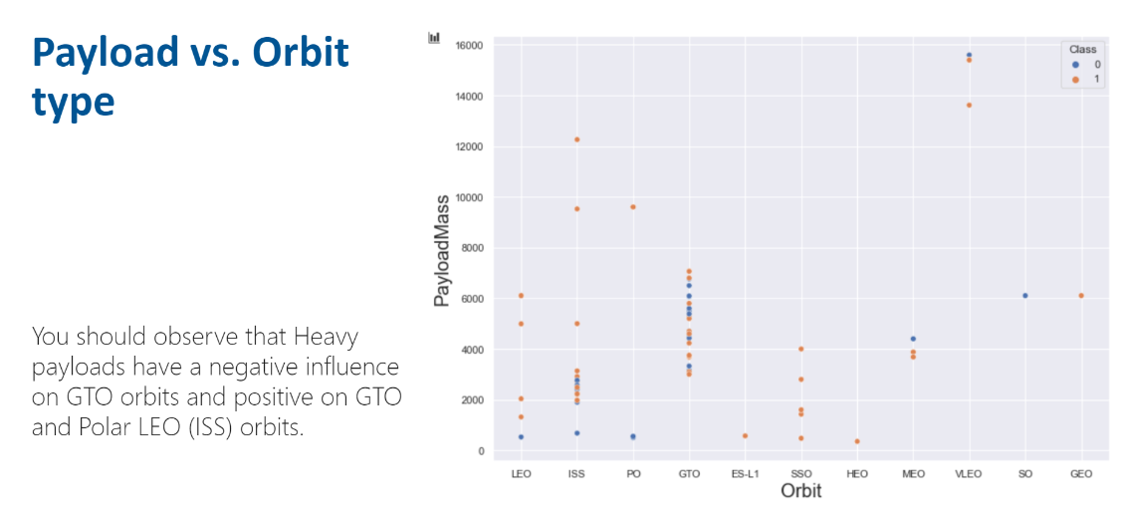
Payload vs. Orbit Type

Slide 23
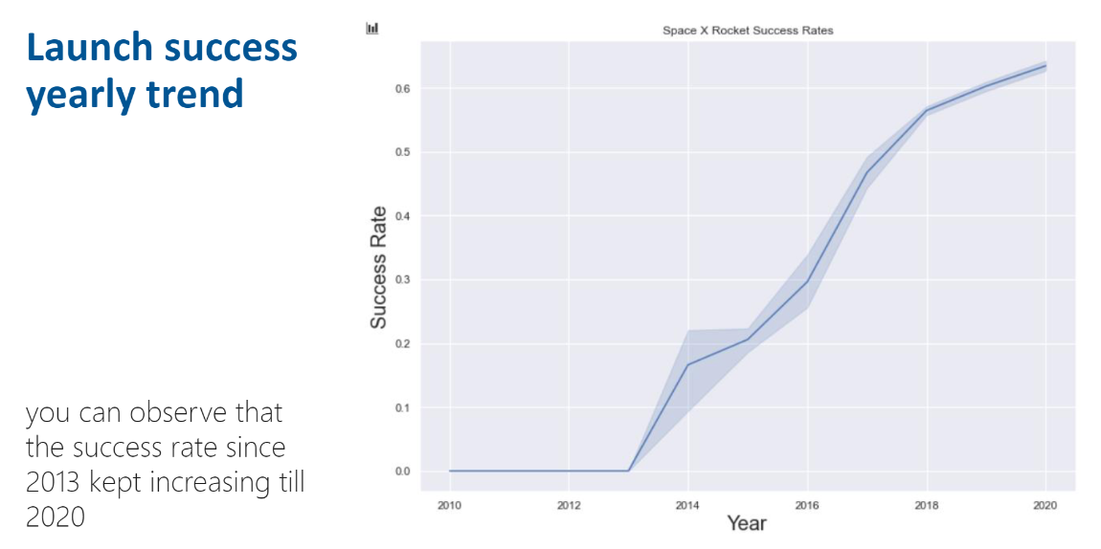
Launch Success Yearly Trend

Slide 24
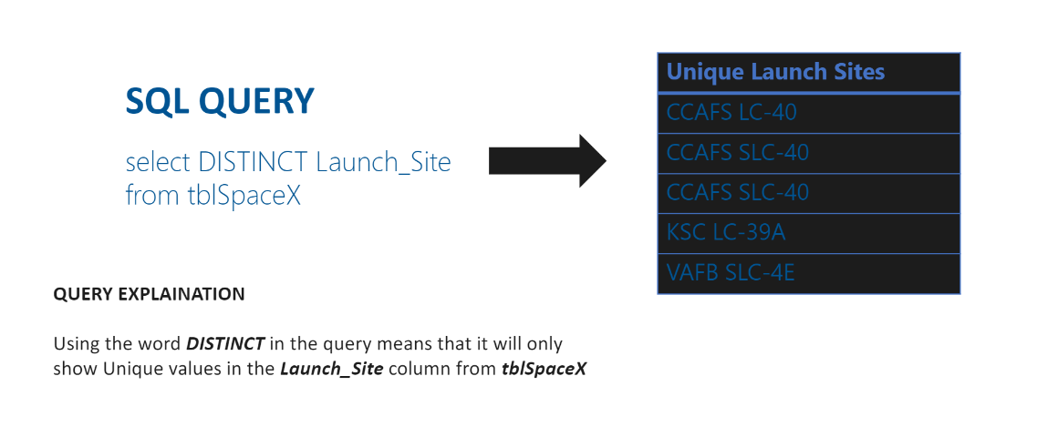
All Launch Site Names

Slide 25
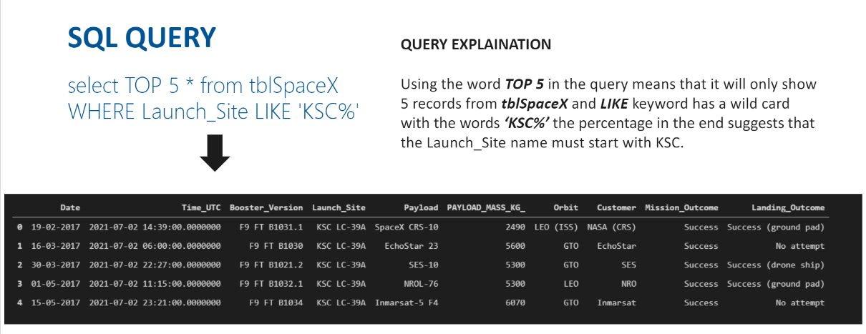
Launch Site Names Begin with 'CCA'

Slide 26
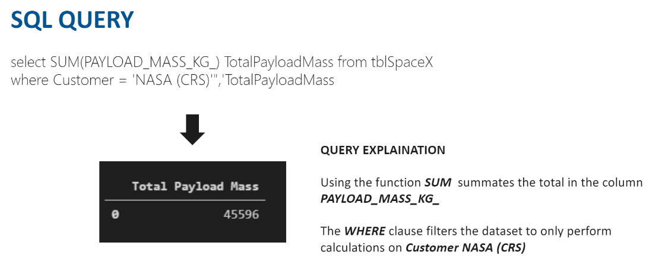
Total Payload Mass

Slide 27
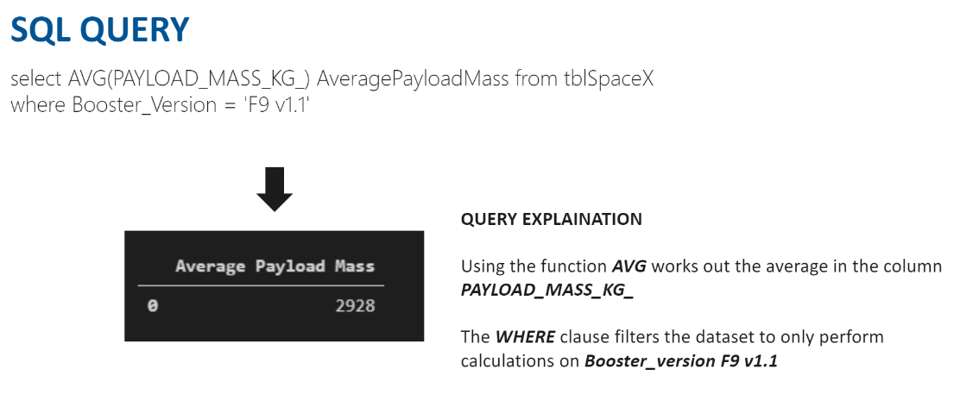
Average Payload Mass by F9 v1.1

Slide 28
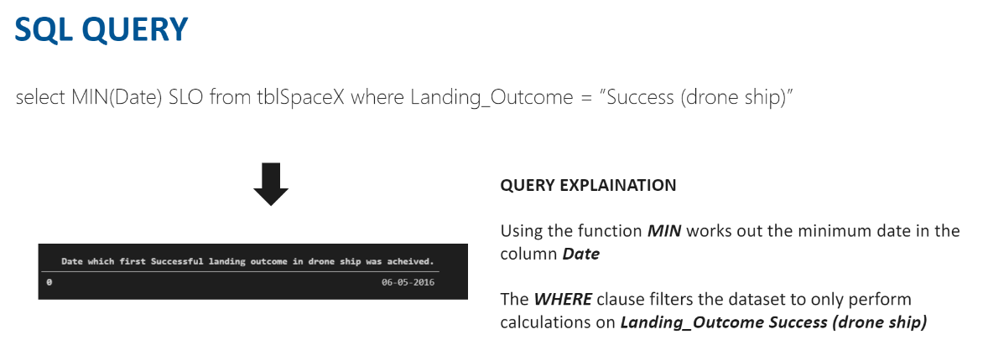
First Successful Ground Landing Date

Slide 29
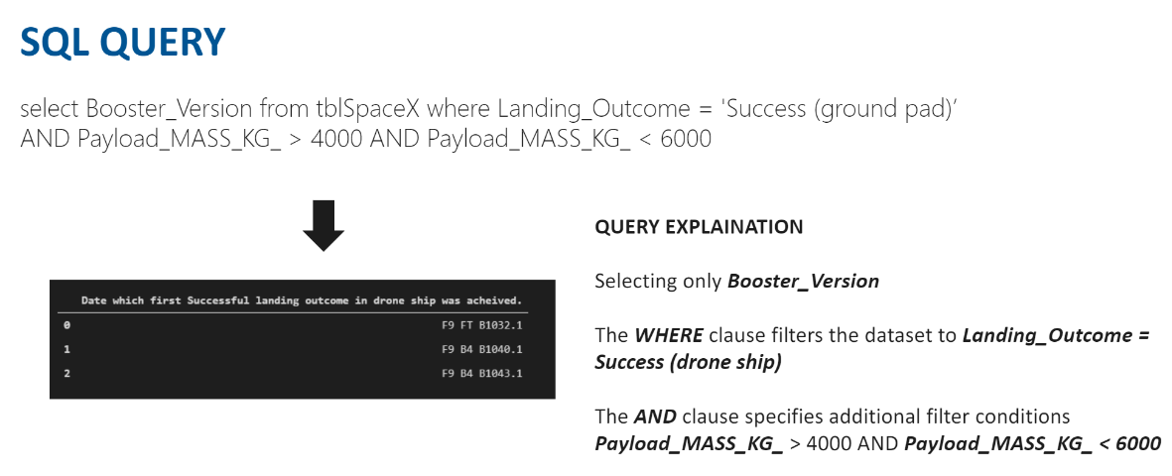
Successful Drone Ship Landing with Payload between 4000 and 6000

Slide 30
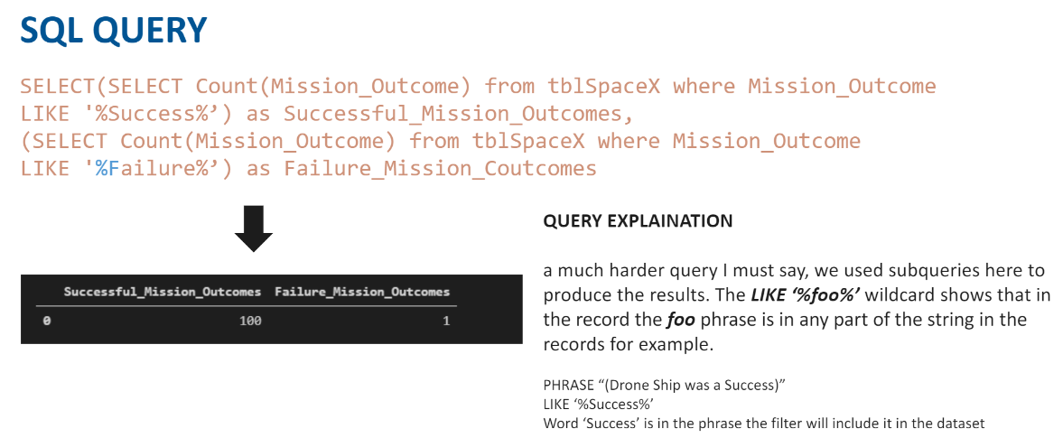
Total Number of Successful and Failure Mission Outcomes

Slide 31
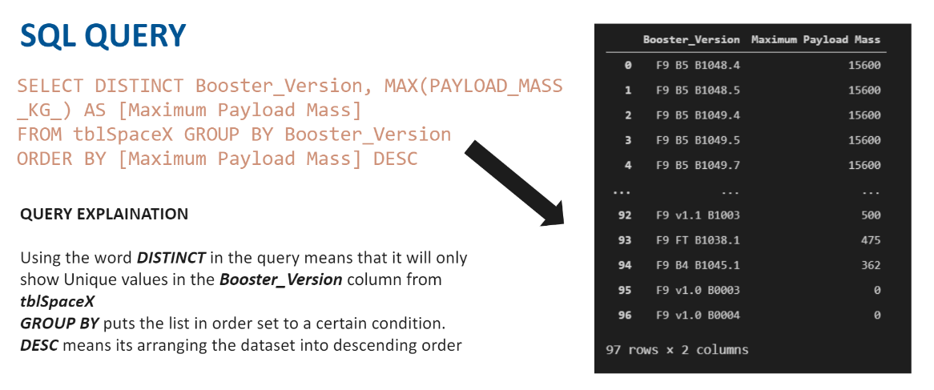
Boosters Carried Maximum Payload

Slide 32
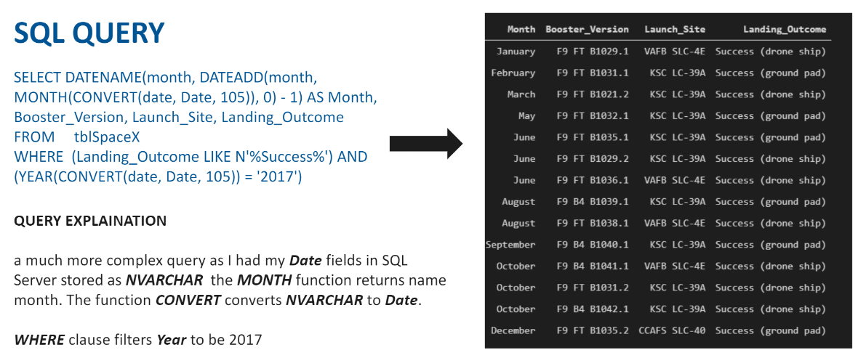
2017 Launch Records

Slide 33
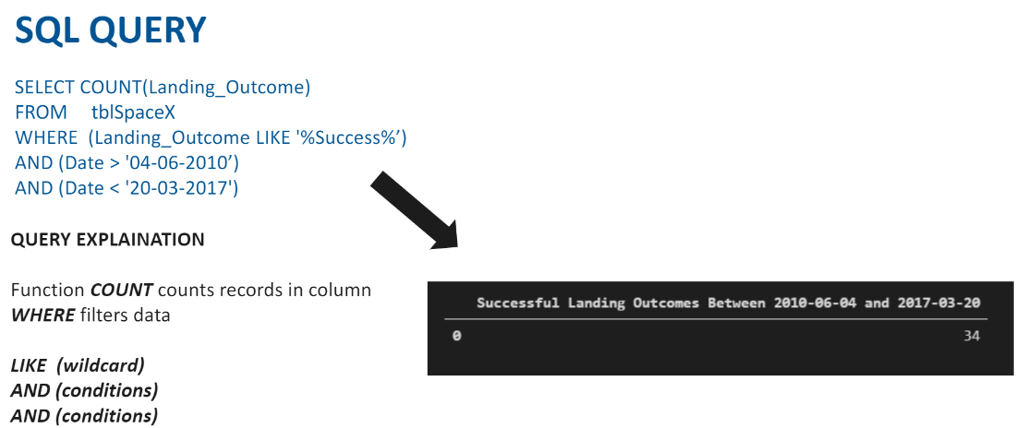
Rank Landing Outcomes Between 2010-06-04 and 2017-03-20

Slide 34


Slide 35
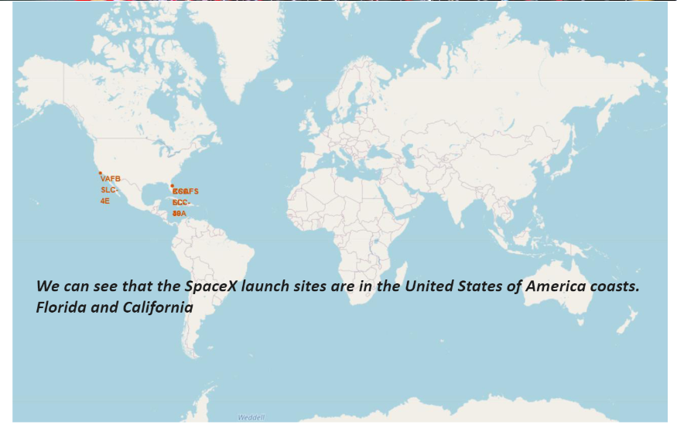
All Launch Sites

Slide 36
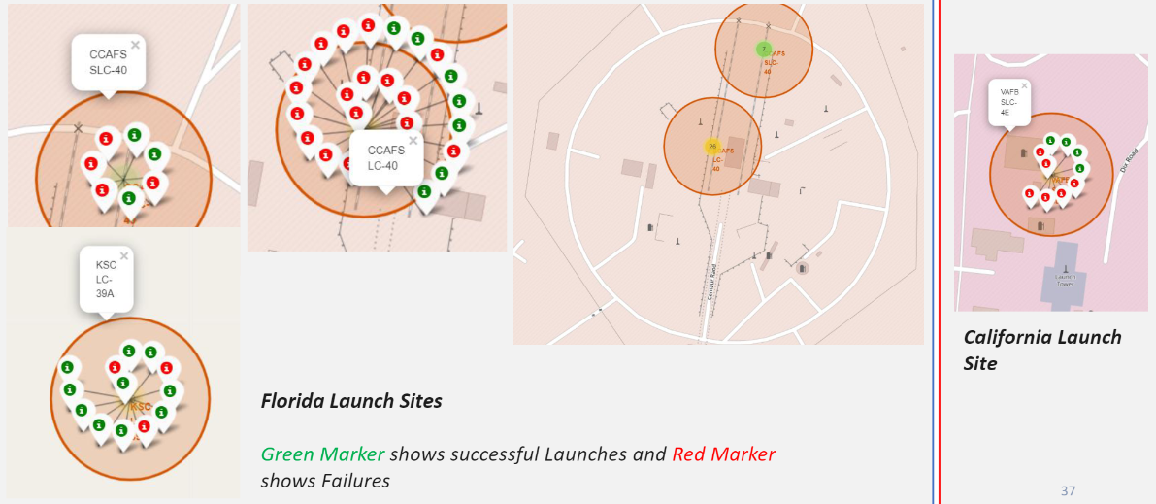
Color Labeled Markers

Slide 37
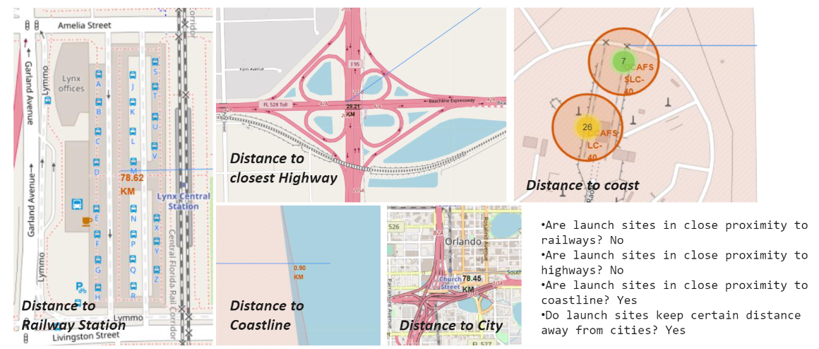
Distance from Landmarks

Slide 38


Slide 39
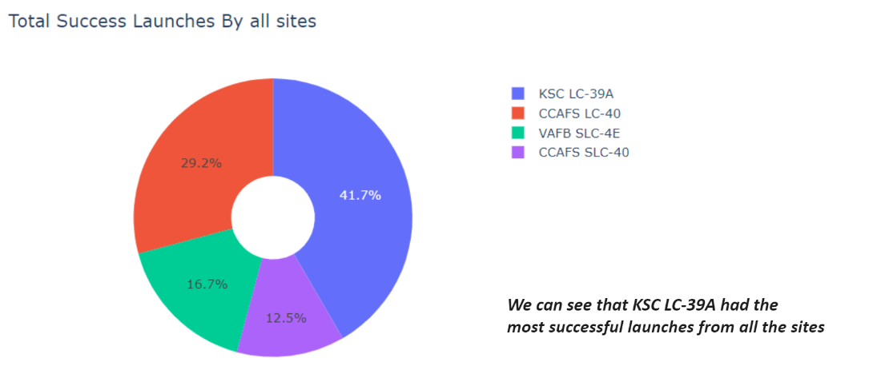
Summary of Successful Launch Sites

Slide 40
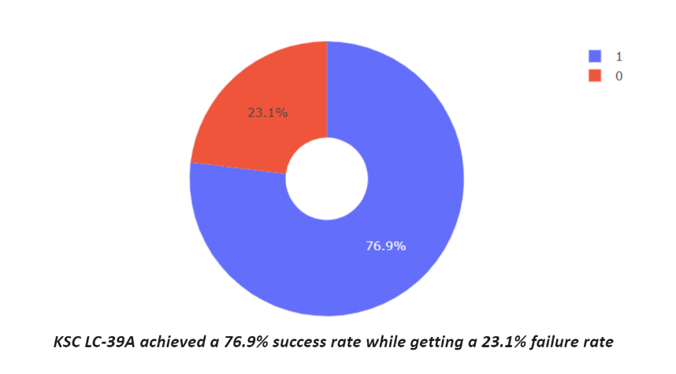
Most Successful Launch Site

Slide 41
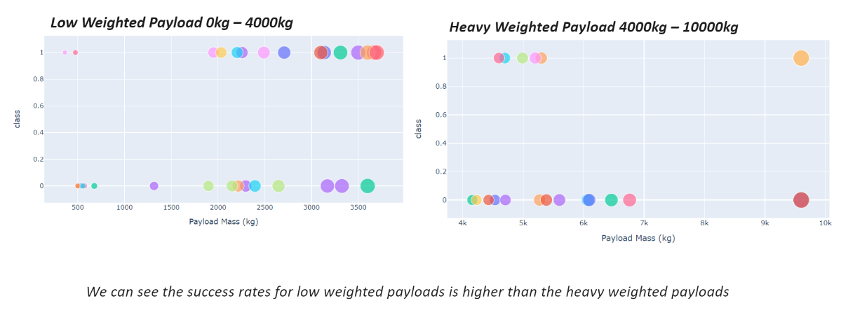
Success by Weight of Payload

Slide 42


Slide 43
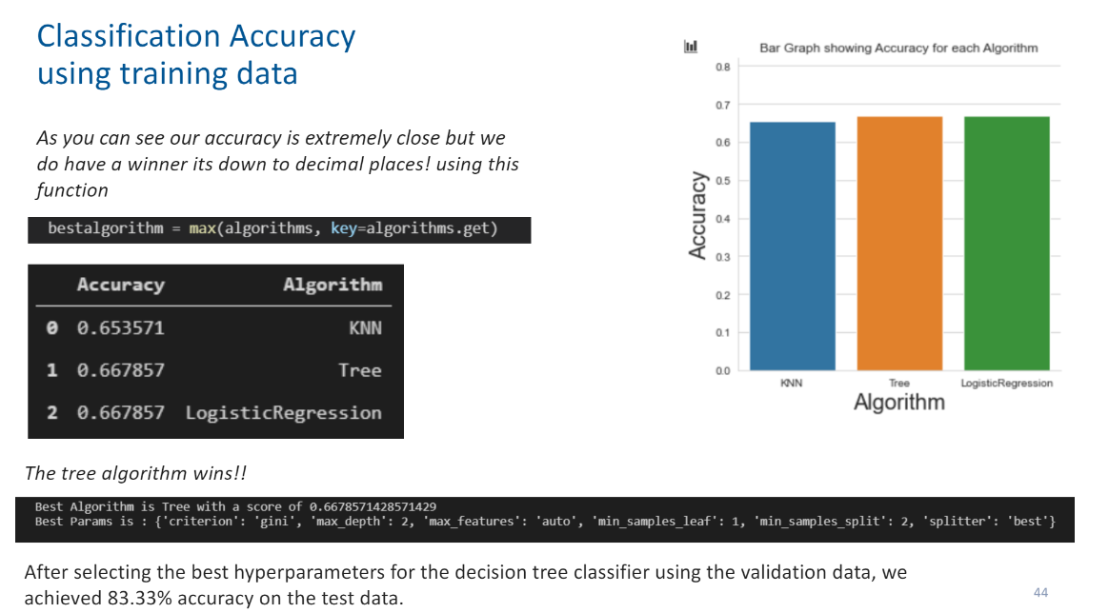
Classification Accuracy

Slide 44
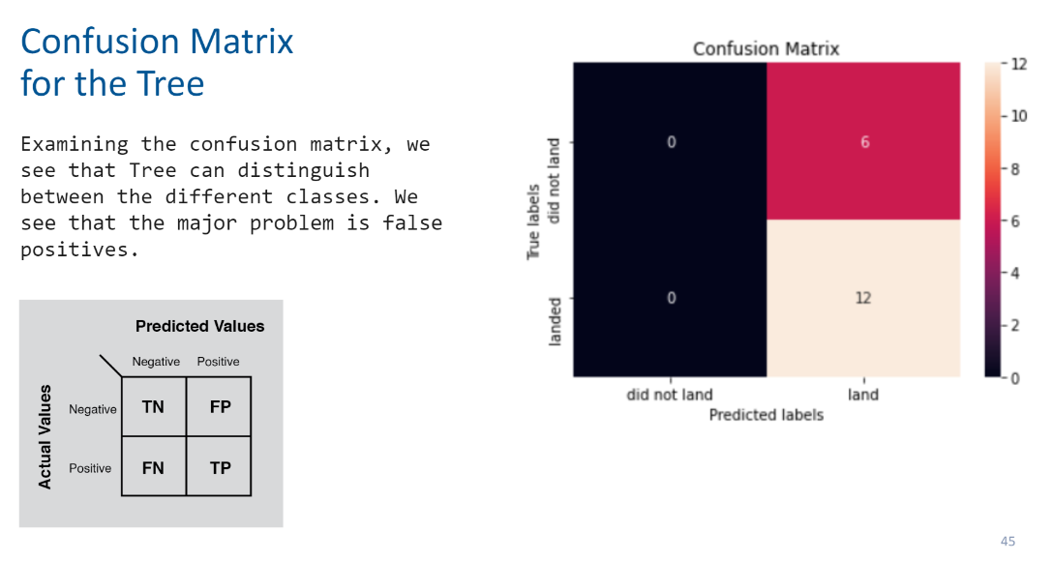
Confusion Matrix

Slide 45
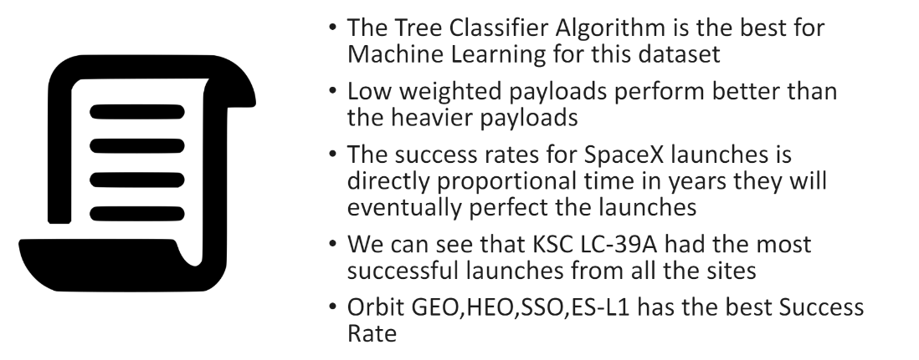
Conclusions

Slide 46


